Slide 1
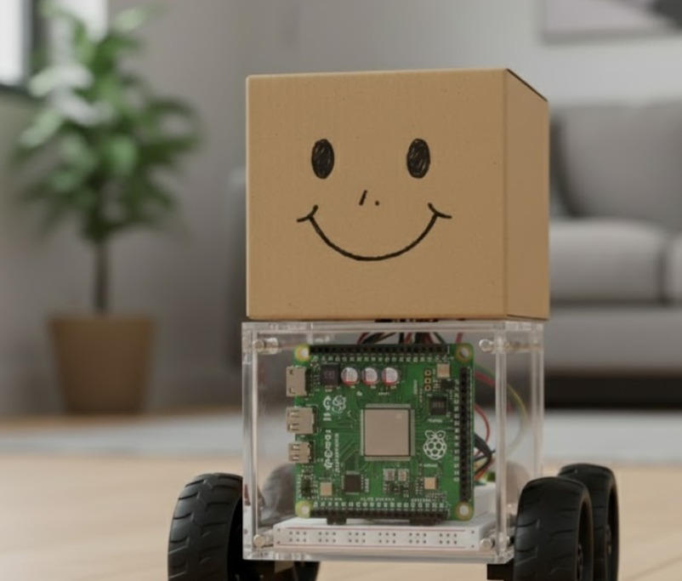


Slide 2

Problem
Solution
Desirability
Feasibility
Viability
Prototype
For millions with mobility challenges, a reliable helper isn't a luxury—it's a necessity.
In today’s smart home environment, users rely on multiple disconnected devices — smart speakers for commands, separate bots for cleaning, and mobile apps for automation — none of which provide personalized, mobile, and camera-free assistance.
Elderly individuals, differently-abled users, and busy professionals often face difficulties in:
Moving to interact with static devices (like Alexa or Google Home).
Managing home automation when their hands are occupied.
Maintaining privacy since most smart assistants use cameras or cloud storage for tracking.
Thus, there is a need for a low-cost, privacy-preserving, mobile smart assistant that can physically follow the user, understand commands, and control smart devices autonomously without depending on cloud vision or expensive hardware.

Slide 3
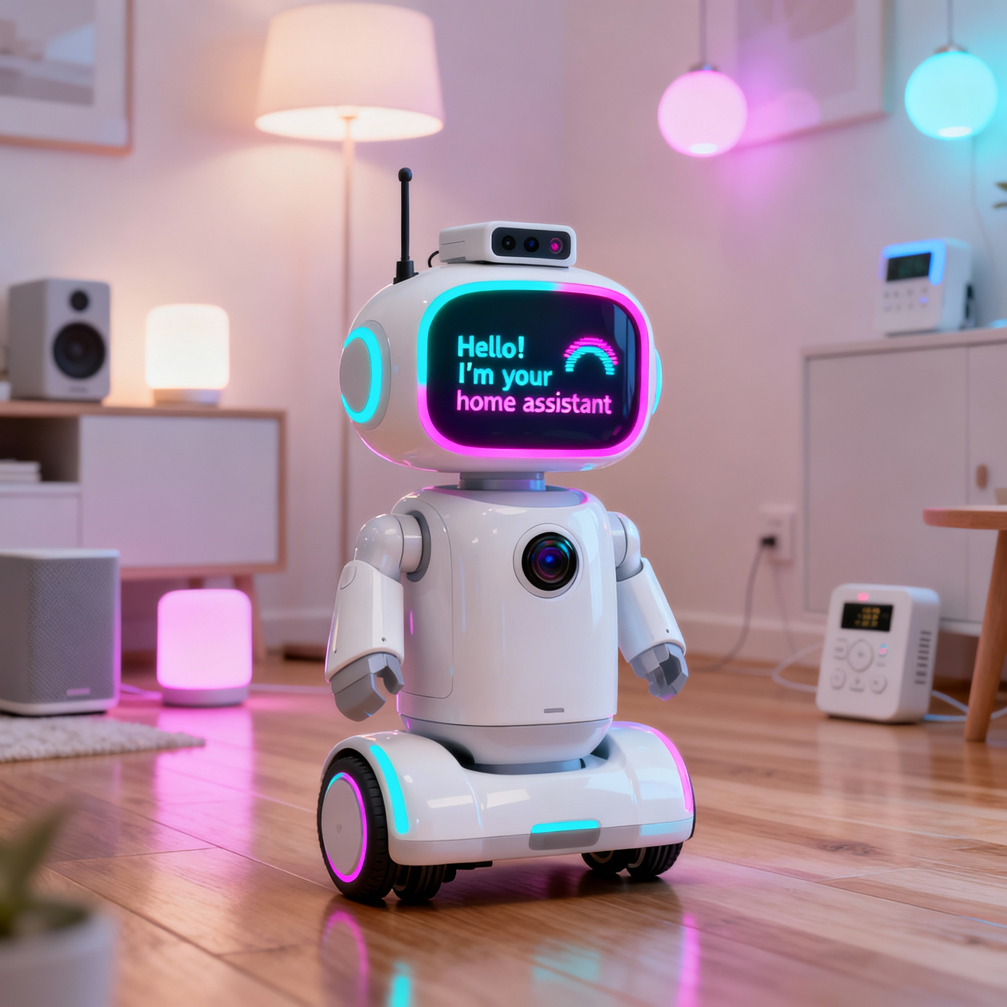
Problem
Solution
Desirability
Feasibility
Viability
Prototype
Our solution is an AI-powered healthcare companion that offers safety, support, and friendship.
The Brain: A powerful Raspberry Pi 5 runs all onboard AI, which ensures a fast and private user experience.
Constant Monitoring: It tracks the user's location through GPS and syncs with personal health devices, like a wearables to check vital signs.
A Friendly Voice: The bot can chat and engage in conversation, providing companionship and important reminders, even when offline.
Intelligent Awareness: With its camera module and ultrasonic sensors, it safely navigates the user's home, staying close without getting in the way..We can even control through mobile by making mobile simulation of house and controlling through mobile anywhere.

Slide 4

Problem
Solution
Desirability
Feasibility
Viability
Prototype
It's proactive, not reactive. By tracking health data from a wearables, it provides insights and alerts without needing constant input.
It's always there. Its ability to work online and offline makes it a reliable partner, not just an internet-dependent tool.
It's a friend, not just a machine. The ability to have natural conversations makes it a welcome addition to the home, changing it from a utility to a desirable companion.

Slide 5
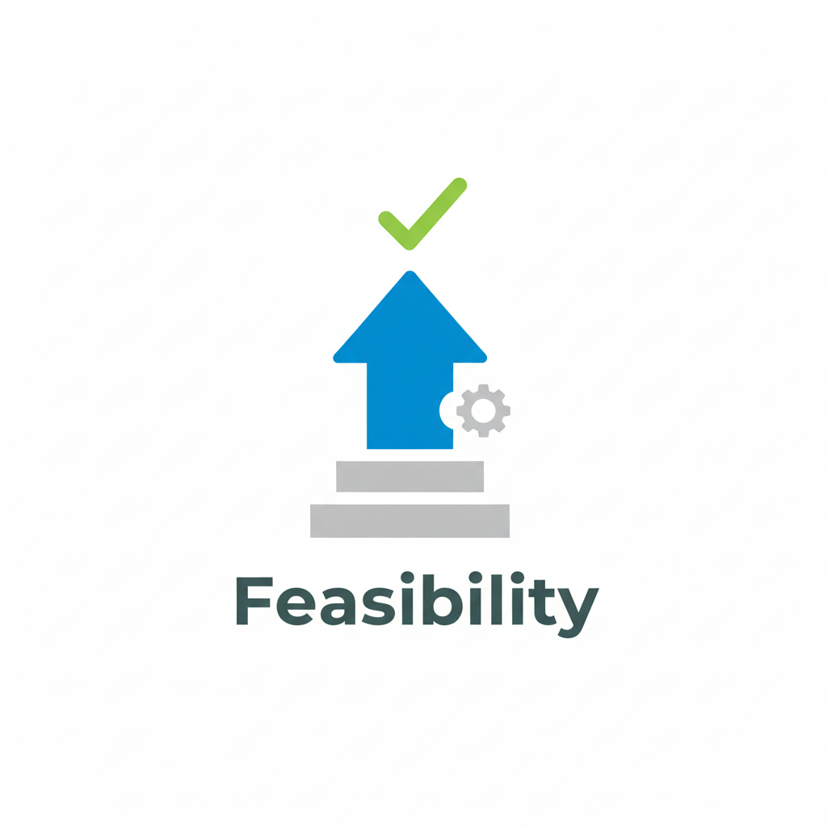
Problem
Solution
Feasibility
Viability
Prototype
This AI Healthcare Bot is very feasible. It uses low-cost, reliable technology and a simple, effective design.
Low-Cost and Proven Hardware: The bot is made with dependable, off-the-shelf components like Raspberry Pi 5 and Arduino.
Simple and Smart Design: The bot follows a person by detecting signals from a wearable smart band, avoiding cameras and preserving privacy, while ultrasonic sensors handle obstacle avoidance for safe, low-cost navigation.
Achievable Software: The AI brain runs on standard Python and well-documented APIs from services like OpenAI, making the voice interaction and logic easy to implement.

Slide 6

Problem
Solution
Feasibility
Viability
Prototype
This AI Healthcare Bot is a promising venture because it addresses an important market need with an affordable and appealing product.
Clear Market Demand: It addresses a significant and growing need for affordable assistive care, where current options are often too expensive or complicated.
Profitable & Accessible: With a build cost under ₹15000, it can be priced reasonably for users while still providing a strong profit margin, which makes the business case strong.
Trustworthy & Desirable Solution: Its camera-free, privacy-first design makes it reliable for home use, and features like "chitchat" make it a friendly companion.

Slide 7
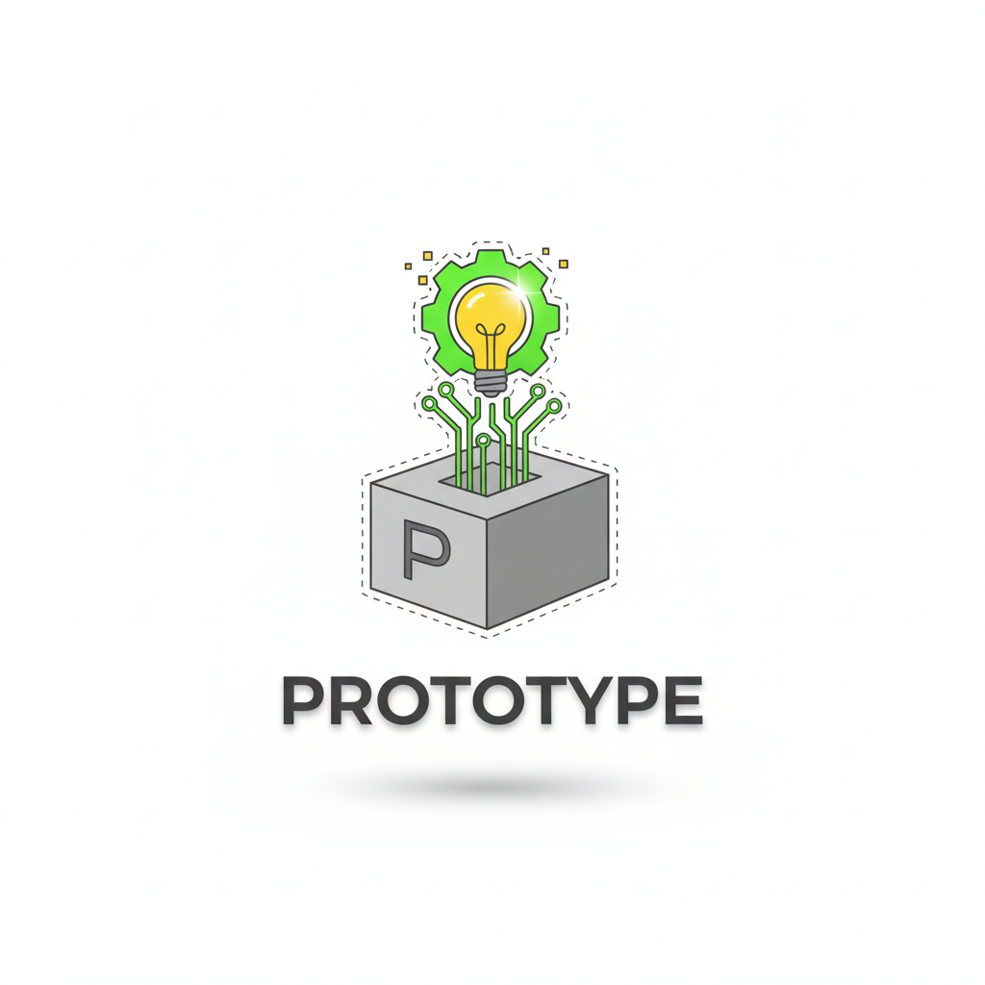
Problem
Solution
Feasibility
Viability
Prototype
How It Works:
Camera-Free Following: The bot tracks the user by sensing the Wi-Fi signal strength (RSSI) from their smartphone. It moves toward a stronger signal and changes direction when the signal weakens.
Intelligent Obstacle Avoidance: Onboard ultrasonic sensors constantly scan for obstacles and automatically stop the bot to avoid collisions.
Voice Interaction: The Raspberry Pi serves as the AI brain. This setup lets the user ask questions and get helpful spoken responses from AI models like Gemini and ChatGPT.
Key Components:
AI Brain: Raspberry Pi 5
Sensor & Motor Control: Arduino UNO and ESP8266 Wi-Fi Module
Movement: DC Motors with L298N Driver
Software: Python , wowki, unity ,AIML and Arduino linked via serial communication.

Slide 8
4
60–90 days Optimize path tracking, add obstacle avoidance and battery monitor
Future Scope OptiDevelop mobile app interface & publish open-source model
3
2
30–60 days Integrate Raspberry Pi AI assistant (speech I/O)
1
0–30 days Build basic prototype using Raspberry +Arduino + Wi-Fi + motors

Slide 9
Role
Hardware Engineer
Skills
Circuit design, motor driver control
AJISH V
MONISH
VAISHNAVI
RUDRESH
SAI VIKRAM BALAJI

Slide 10
Role
AI Developer
Skills
Raspberry Pi 5 AI integration
MONISH
RUDRESH
AJISH V
SAI VIKRAM BALAJI
VAISHNAVI S

Slide 11
Role
Software Developer & Simulation Designer
Skills
Software development, AI integration, and realistic simulation design
VAISHNAVI S
RUDRESH
AJISH V
SAI VIKRAM BALAJI
MONISH

Slide 12

Thank You

